Slide 1
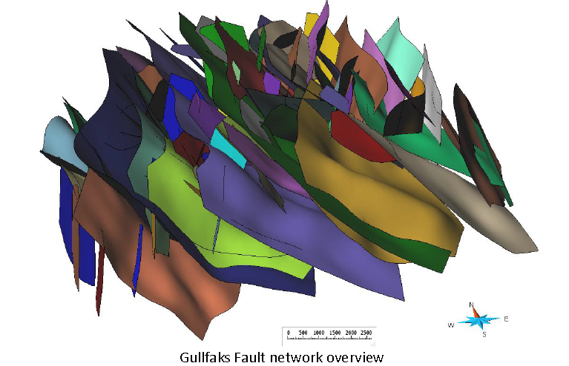
Sharing seismic interpretation data using OSDU Reservoir Domain Data Types: RESQML
13 January 2023
maap@equinor.com

Slide 2
Objective and scope
Use case: sharing and storing seismic interpretations as POC. Focus on interoperability with vendor systems.
Get common understanding of OSDU datatypes available for storage and exchange of
Seismic surface interpretations
Structural frameworks (= surfaces + topology)
Intro to RESQML overall design and OSDU integration
Next Techbite session 19.1.: Reservoir DDMS to support long running workflows and as SOR, incl demo

Slide 3
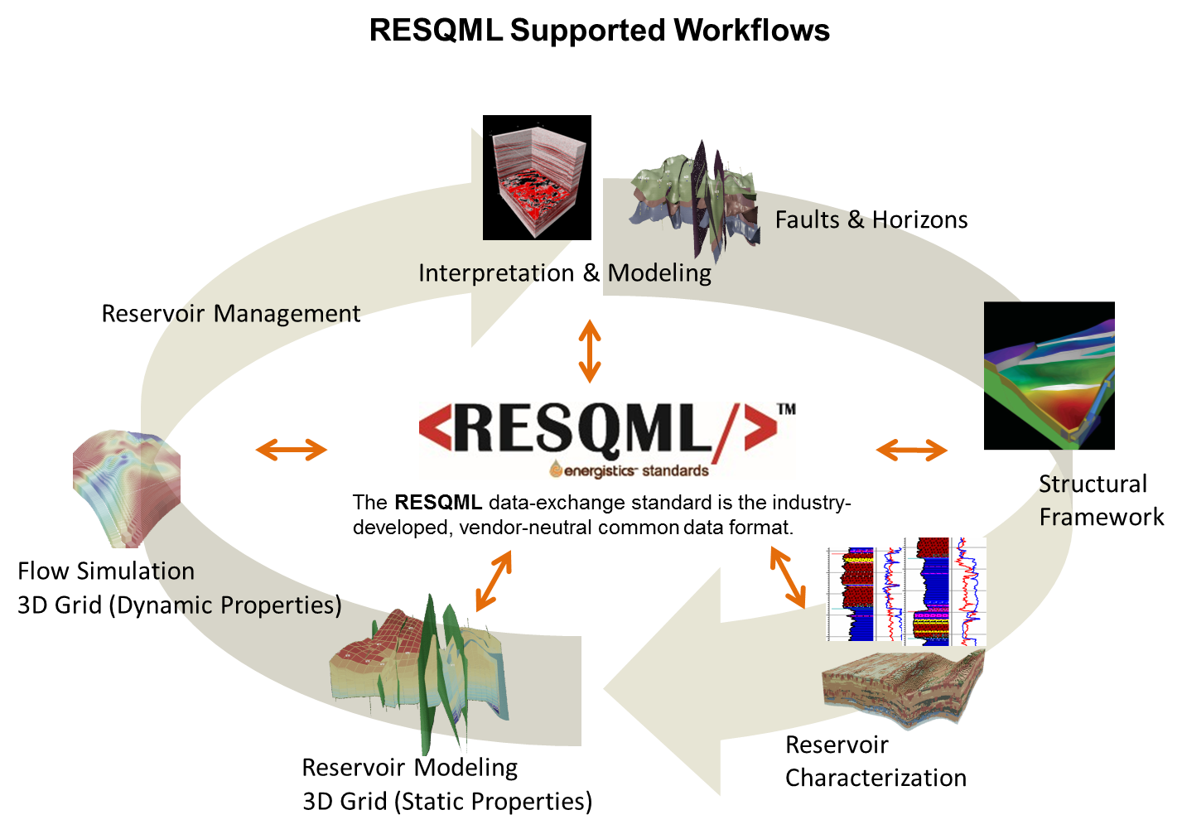
RESQML is …
a data exchange format
designed primarily for reservoir model data (“artefacts”)
a data model defined in XML Schema, coupled with the HDF5 standard for large array data
designed as object-relational
supporting object organizations, relationships among objects and external, traceability, partial updates
supported by multiple open-source libraries

Slide 4
RESQML: characteristics and benefits
Limit information loss/anomalies
The only standard to share reservoir models
Support for scenario & uncertainty
Data relationships: Oriented links indicate how data relate to each other.
Coordinate systems/unit consistency: EPSG & WKT coordinate systems; OSDU-Energistics units of measure
Generic representations allowing separation between domain info & geometry. Extra-meta data
Audit trail: based on Energy Profile of ISO 19115-3:2016
Workflow capture through Activity instance and Activity templates objects
Ease data access/exchange
Separation concept/geometry/property. Accessible/editable independently
Meta-data enables content discovery
Global UUID version + timestamp
Existing API’s
Supported by OSDU Reservoir DDMS as system of record and system of interaction

Slide 5
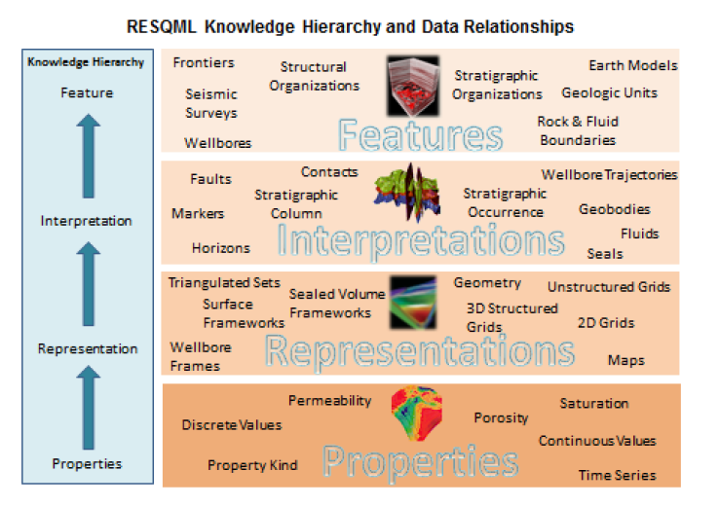
Data model: OSDU Schema definitions based on RESQML ontology
Hierarchical data model, maintain relationships and semantic hierarchy
Feature: physically exists. Could be Geologic, Technical or earth model organization-related
Interpretation: an “opinion” of a feature
Representation: digital description. Includes topology & geometry. Can be individual objects or related “sets”
Property: value on indexable element of a representation, may be Continuous, Discrete, Categorical, Comment.
Notes:
The feature/interpretation/representation/properties knowledge hierarchy (referred to informally as "FIRP") is a new concept in RESQML; it makes data organization more precise and data exchange more efficient. To establish a “knowledge hierarchy,” asset team members specify relationships between instances of data objects using a RESMQL mechanism called a data object reference (DOR

Slide 6
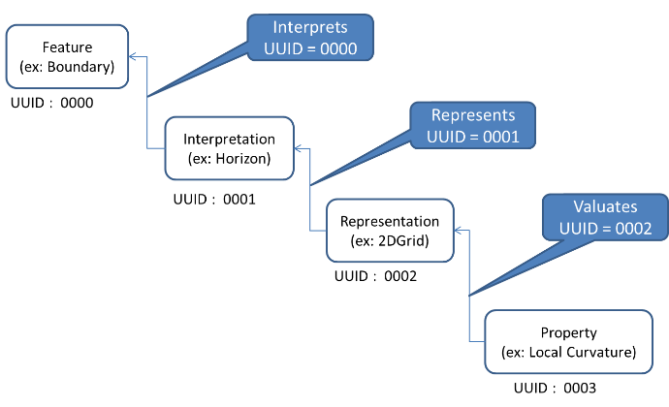
Object reference and multiple interpretations
Implementation of relationships:
Feature
Interpretation
Representation
Property
Representations can be associated with Interpretation
Identification and traceability
UUID and Energy Industry Profile (EIP) metadata, part of OSDU SRN
“Content” of objects/ “Partial-model” transfer
Interpretation
(ex. Another Horizon)
UUID : 1001
Representation
(ex: Points)
UUID : 2002
Property
(ex: Transmissibility)
UUID : 1003
Notes:
example (beginning at the left), the feature (UUID 0000) has 2 interpretations (UUIDs 0001 and 1001); interpretation 0001 has 2 representations (UUIDs 0002 and 1002), and representation 0002 has 2 properties (UUIDs 0003 and 1003).
Object-relationship in XML
Use of object references
Objects must be uniquely identified
Designate relationships between the objects
Group together related objects as collections, "package"

Slide 7
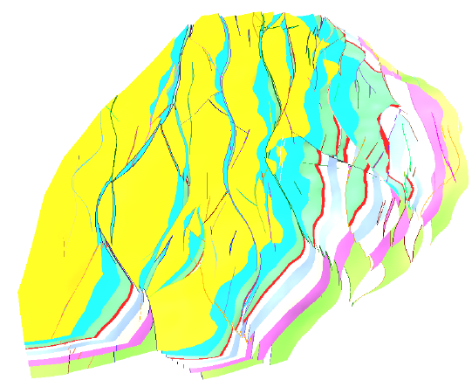
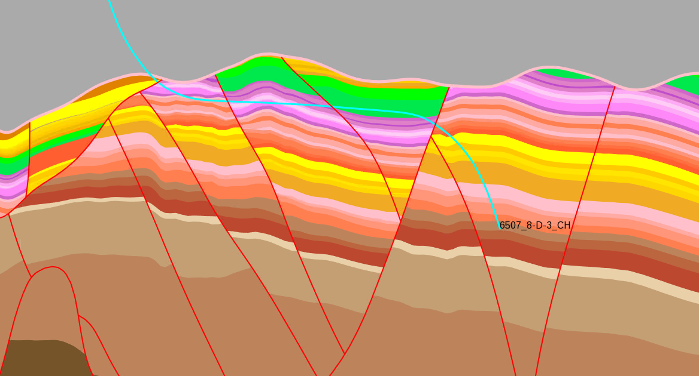
Topology and RESQML
Representation:
Topology defines how to associate nodes, surfaces and other “indexable elements” to represent points, lines, surfaces, surface frameworks, or volumes
Geometry: includes spatial location of indexable elements
This is how we “attach” properties
Model
Shall we share interpretations as Surfaces or Surface Frameworks?
Topology: Relations and contacts cross representations
Example of model topologies

Slide 8
Demo import & export: horizons, faults, structural framework
EPC files
ETP

Slide 9
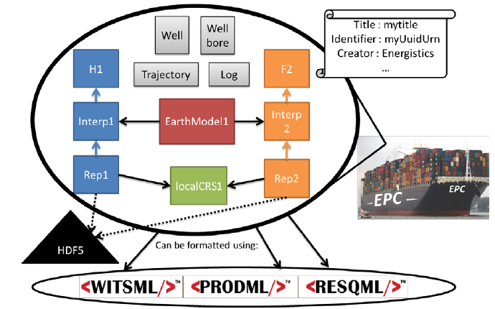
Data Transfer options
Files
1+ EPC zip file, containing XML documents, ref HDF5 file
1+ HDF5 file(s) containing multidimensional array data
Energistics Packaging Convention EPC standard describes the specialization of OPC: organizes XML documents, describes relationships among files
API
ETP
No files needed; uses Avro and Websocket. Fast.
Supports transaction, notification
REST or other APIs (like ODATA on an ETP store)
Use ETP semantics
Can use XML or JSON encoding
ETP Clients:
OSDU ETP Client (donation AspenTech RESQML V2.0.1)
FETPAPI (F2-I Consulting)
WEB Studio RESQML V2.0.1 (Geosiris, TBD)
ETP Servers:
OSDU Reservoir DMS (donation AspenTech, for RESQML V2.0.1 using Postgres)
OSDU External Data Source : Gabbro RESQML V2.0.1 & V2.2 using HSDS and a GraphDB (Geosiris)

Slide 10

Developing for RESQML - Resources
Open source libraries
OSDU Reservoir DDMS client (C++ or TypeScript; by AspenTech)
FESAPI (RESQML 2.0.1, 2.2) FETPAPI (ETP 1.2, not as mature as FESAPI)
Developed for Windows/Linux/macOS in C++ with SWIG wrappers for: Java, C#, Python
Experimental support Javascript (WebAssembly)
Basic community support forum : FESAPI FETPAPI
resqpy (Python RESQML 2.0.1 parser/classes/utilities; no ETP yet; by BP)
Interaction, support, documentation
OSDU RESQML Workgroup RESQML - General Information and Documents · GitLab (opengroup.org)
OSDU #resqml Slack channel, biweekly forum
RESQML 2.0.1 & 2.2 release; Documentation (release notes, usage guide, tech ref)
Other Open Source tools
WebStudio, Python parser, ETP API, RESQML 2.0.1 & 2.2; by Geosiris)

Slide 11
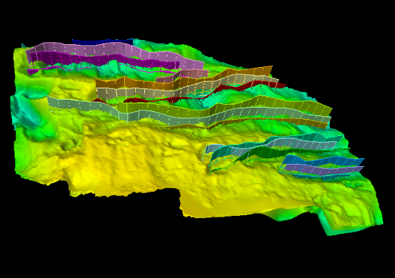
Use case definition for POC – Open discussion
Options for seismic interpretation transfer in time or depth
Multiple interpretations of Features («scenarios»)
HorizonInterpretation: contains meta data such as feature name, domain, age range, conformity, stratigraphic role
StructuralOrganizationInterpretation
Multiple representations (resolution, geometry) for each Interpretation:
2dGridRepresentation or PointSetRep or TriangulatedSetRep
UnSealedSurfaceFramework (topology: horizon-horizon, horizon-fault and fault-fault relationships)
Test data set, available as i) EPC files and ii) ETP server/RDDMS:
Volve depth horizons, fault sets
Volve depth structural framework

Slide 12
Main RESQML types and OSDU Work Product Component equivalents
Supported RESQML types and their OSDU Work Product Component equivalents
RESQML | OSDU WPC
CategoricalProperty ContinuousProperty DiscreteProperty | GenericProperty
FaultInterpretation | FaultInterpretation
GeneticBoundaryFeature OrganizationFeature | LocalBoundaryFeature
GridConnectionSetRepresentation | GridConnectionSetRepresentation
HorizonInterpretation | HorizonInterpretation
IjkGridRepresentation | IjkGridRepresentation
LocalDepth3dCrs LocalTime3dCrs | LocalModelCompoundCrs
StratigraphicUnitFeature | StratigraphicUnitFeature
PolylineRepresentation PolylineSetRepresentation PointSetRepresentation Grid2dRepresentation Grid2dSetRepresentation TriangulatedSetRepresentation | GenericRepresentation
PropertySet RepresentationSetRepresentation | PersistedCollection
StratigraphicColumn | StratigraphicColumn
StratigraphicColumnRankInterpretation | StratigraphicColumnRankInterpretation
StratigraphicUnitInterpretation | StratigraphicUnitInterpretation
StringTableLookup | ColumnBasedTable
SubRepresentation | SubRepresentation
TimeSeries | TimeSeries
Non-SealedSurfaceFrameworkRepresentation | UnSealedSurfaceFramework
SealedSurfaceFrameworkRepresentation | SealedSurfaceFramework
StructuralOrganizationInterpretation | StructuralOrganizationInterpretation
WPC types contain the meta-data available for OSDU platform search; deep search available through DDMS
Complete list of data types

Slide 13
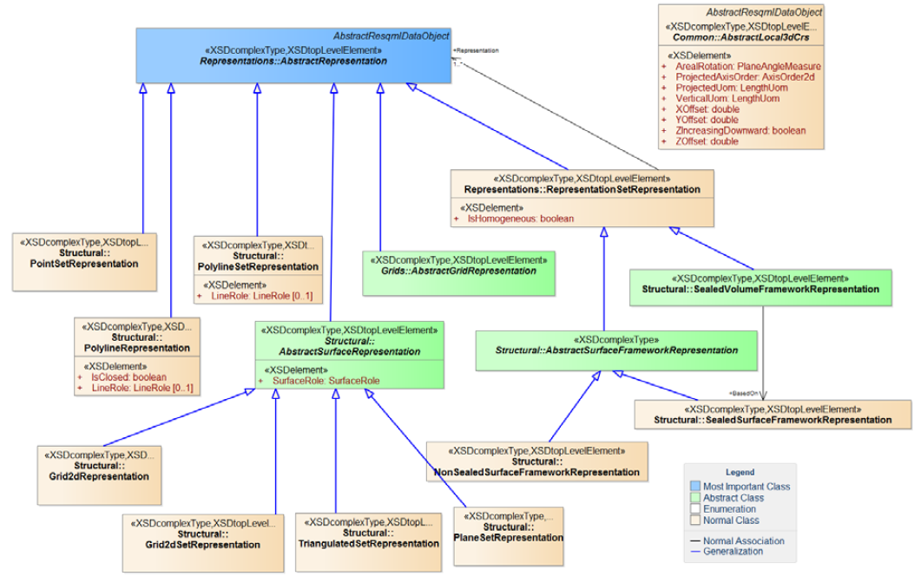
Surface interpretations and their representations as WPC
For horizon interpretation, we have:
Grid 2D representation with their 2D point lattice
Triangulated surface representation
Subrepresentation (by interval edge) of the 3D grid
For fault Interpretation, we have:
Polyline set representation
Triangulated surface representation
Subrepresentation (by list of faces) of the 3D grid
For organizations, we have these representations:
Non-sealed surface framework
Sealed surface framework
Sealed volume framework
3D grid
GenericRepresentation WPC: Grid2dRepresentation

Slide 14
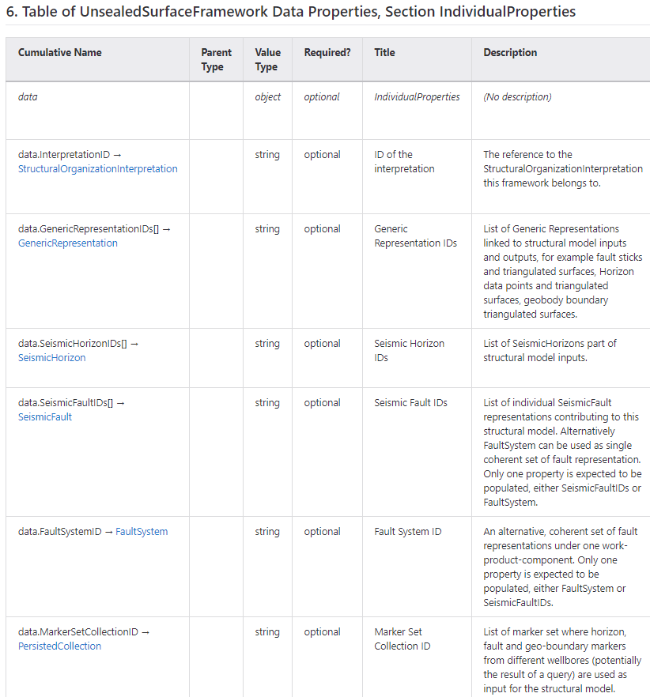
UnsealedSurfaceFramework WPC
Candidate for sharing seismic interpretations?
Metadata for E-R/work-product-component/UnsealedSurfaceFramework.1.1.0.md · master · Open Subsurface Data Universe Software / Data Definitions and Services / Data Definitions · GitLab (opengroup.org) :

Slide 15
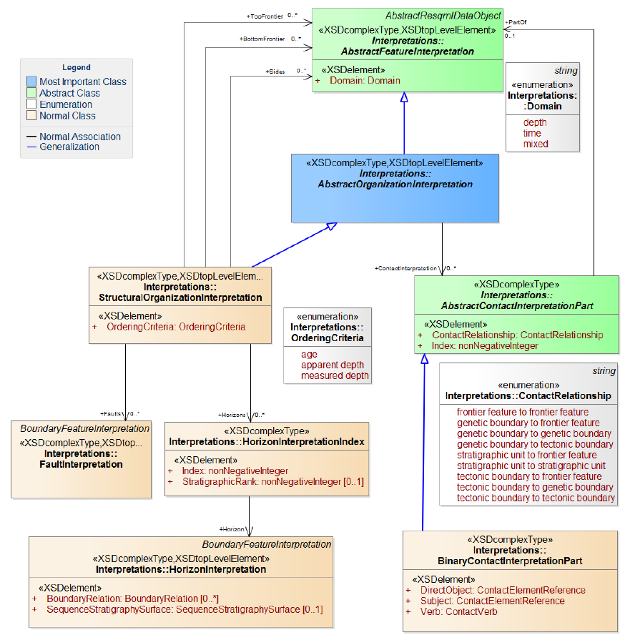
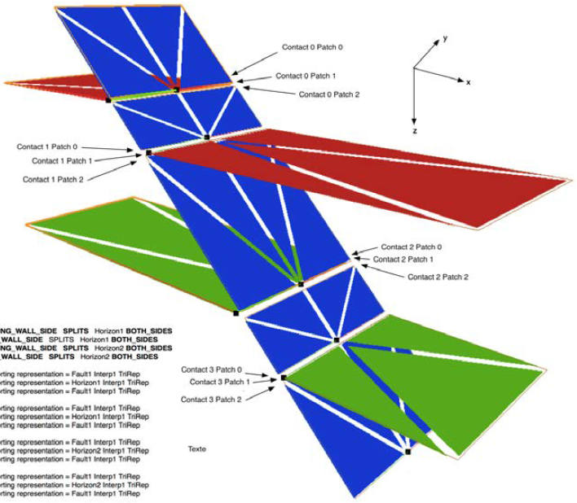
From Horizon & FaultInterpretation to StructuralOrganizationInterpretation

Slide 16
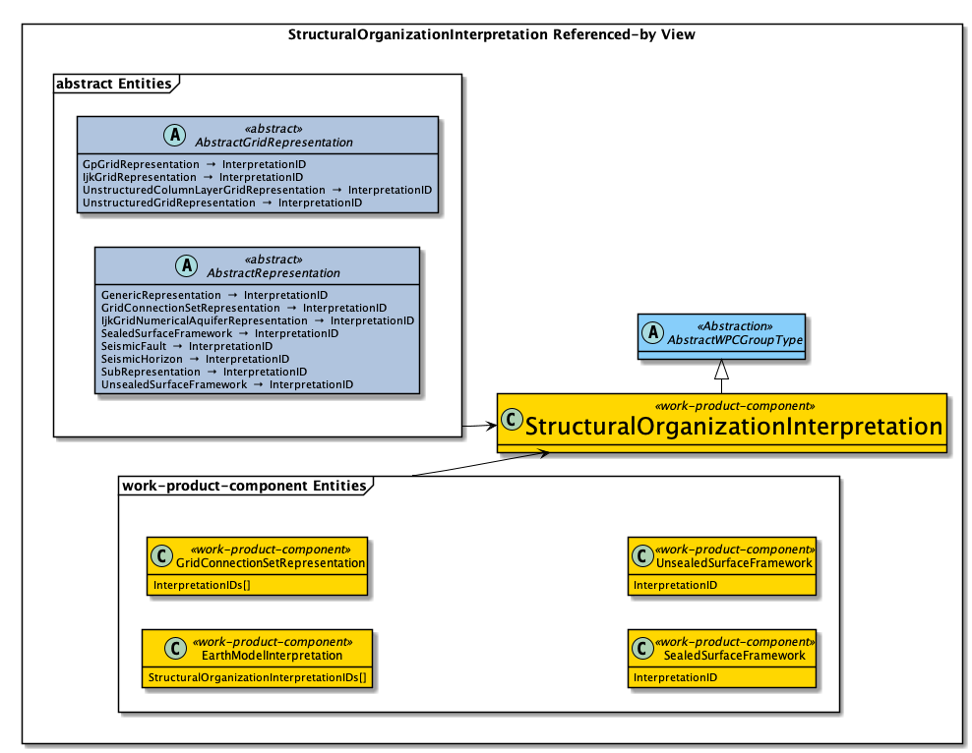
RESQML and WPC StructuralOrganizationInterpretation
WPC StructuralOrganizationInterpretation

Slide 17
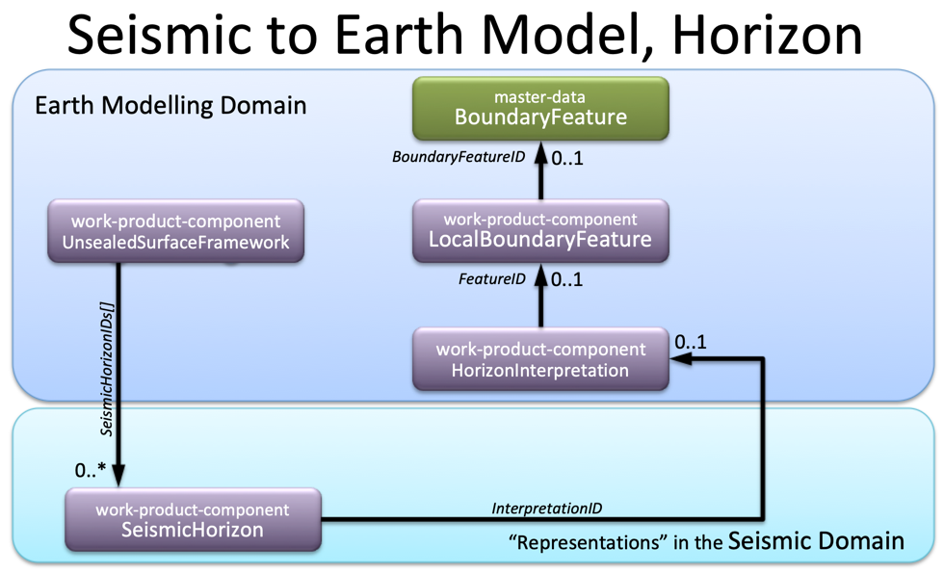
Seismic horizon interpretations in seismic and in reservoir modelling domain
Seismic Interpretation is tightly related to the seismic geometry, 3D Bin Grid for 3D and Seismic Line Geometry for 2D seismic. This is reflected in the interpretation representations SeismicHorizon and SeismicFault.
Reservoir Modelling domain
Reservoir Modelling Domain

Slide 18
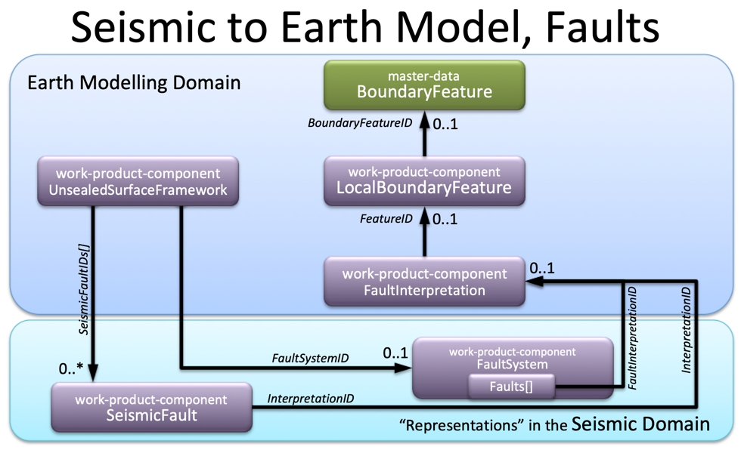
Seismic fault interpretations in seismic and in reservoir modelling domain
Seismic Interpretation is tightly related to the seismic geometry, 3D Bin Grid for 3D and Seismic Line Geometry for 2D seismic. This is reflected in the interpretation representations SeismicHorizon and SeismicFault.
For fault interpretation representations OSDU offers two ways of aggregation into a UnsealedSurfaceFramework:
use collection of faults in a FaultSystem, which may contain different representations of faults in one dataset. Each member of the data.Faults[] array is described by representation role and type.
reference of individual fault interpretation representations. Using SeismicFault is symmetric to the way SeismicHorizon are referenced from the framework.
Reservoir Modelling Domain

Slide 19
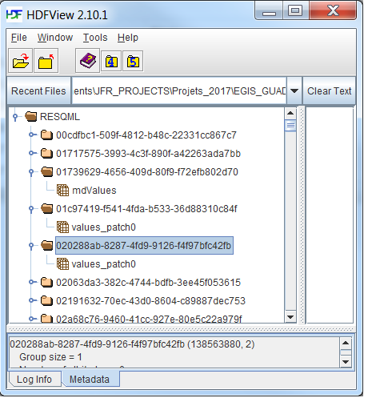
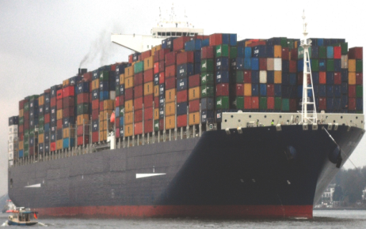

Energistics Packaging Convention (EPC) –
the file alternative to ETP API
Zip File : . epc
Title : mytitle
Identifier : myUuidUrn
Creator : Energistics
…
Wellbore
Hdf_File. h5
Well
Hdf data structures
H1
F2
Trajectory
Log
STRUCTURED
BINARY DATA
Interp1
Geomodel1
Interp2
Rep1
localCRS1
Rep2
Can be formatted using
Can be packaged into
EPC
EPC
Notes:
Container ship photo from wikipedia : http://fr.wikipedia.org/wiki/Fichier:CMA_CGM_Marco_Polo_arriving_Port_of_Hamburg_-_16._01._2014.jpg
Licence : Creative Commons paternité – partage à l’identique 3.0 (non transposée)

Slide 20
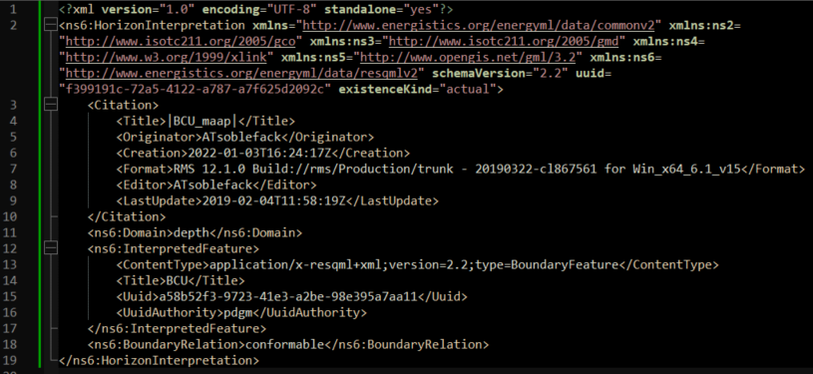
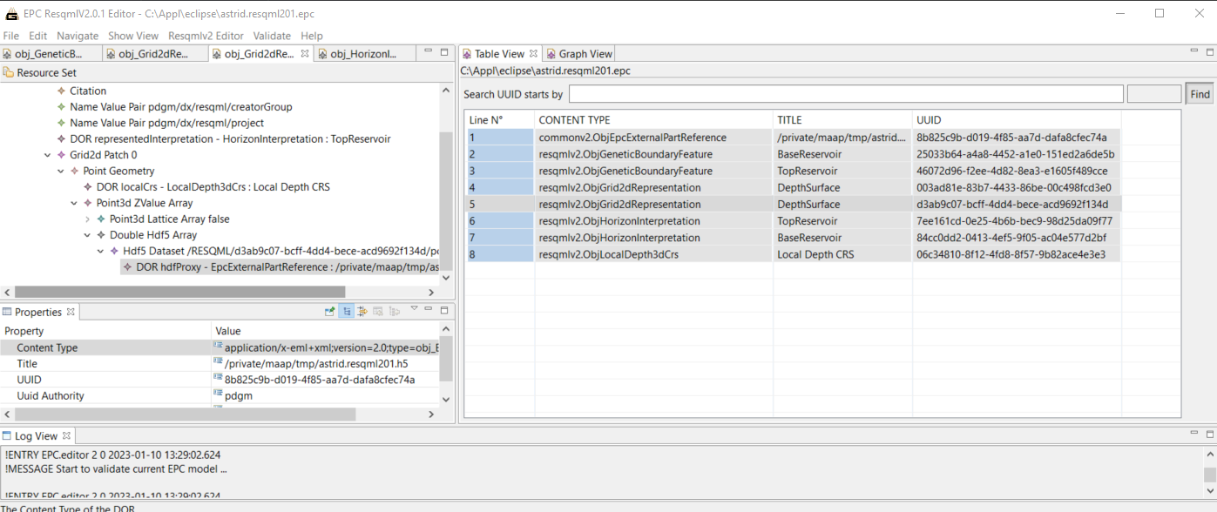
Example epc file
2 surface interpretations and their 2dGrid representations
HorizonInterpretation example (Volve BCU)

Slide 21
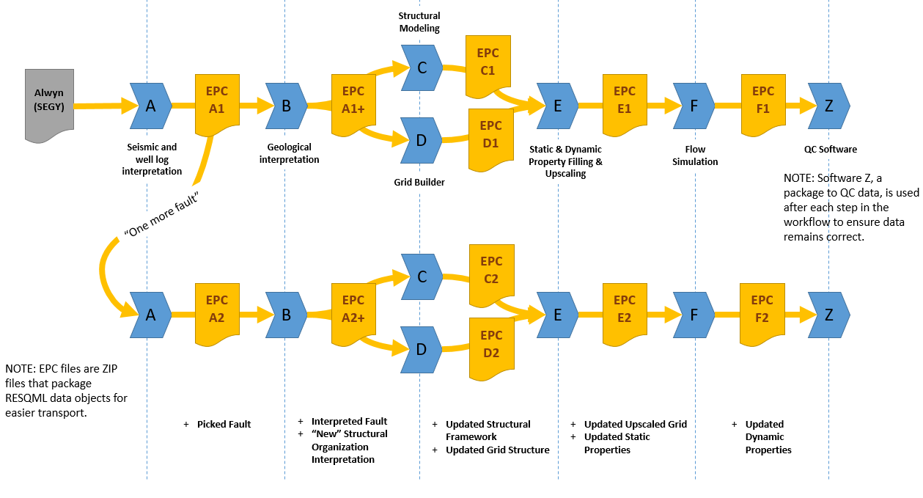
Slide 21
The Scenario, Business Objective, and Role of RESQML
WELL LOG INTERP
STRUCTURAL MODELING
STATIC & DYNAMIC PTY FILLING & UPSCALING
SEISMIC INTERP
GEOLOGICAL INTERP
QUALITY
CONTROL
FLOW SIMULATION
GRID(S) BUILDING
Work flow followed for the first iteration:
Only 4 faults considered

Slide 22
Slide 22
The Scenario, Business Objective, and Role of RESQML
WELL LOG INTERP
Work flow followed for the second iteration:
5 faults considered
SEISMIC INTERP
STRUCTURAL MODELING
STATIC & DYNAMIC PTY FILLING & UPSCALING
GEOLOGICAL INTERP
QUALITY
CONTROL
GRID(S) BUILDING
FLOW SIMULATION

Slide 23
New in RESQML 2.2, released 2022
Workflow follow up (Activity Models)
Project Management (Collections)
Addition of Elements, Attributes and Enumeration to communicate with OSDU R3
Simplification of the Feature Organization (OSDU Catalog master data organization).
Enrichment of the Interpretations (Structure and Enums in accordance with OSDU R3 Catalog DD)
Support for Graphical Information (27 elements)
Cross Links with dedicated WITSML Objects (WellBoreMarkerSet, WellBore trajectory)
Cross Links with dedicated PRODML objects (FluidCompartments, Voidage group)
RESQML & OSDU R3 Catalog aligned on the same design at a high level
RESQML Features are mainly Master Data
RESQML Interpretation, Representation, Property are WPC
RESQML DORs (Data Object Reference) are translated in WPC as kind / id references
RESQML Enums, PropertyKind, QuantityClasses, Units of measure are reference-data
RESQML contains more data, detailed Representation/ property values. Relevant for Reservoir DDMS and query capabilities:
By handling the topology (the indices management) in the Representation Entities
By handling Geometry and Property array description in the Rep and Prop Entities
By handling Geometry and Property Values in numerical Datasets

Slide 24
Q&A

